Slide 1


CITY ASSESSOR’S OFFICE
Brian E. Gordineer, AAS – City Assessor
Br
Assessment
Ordinances
Building a Supportive Legal Framework
April 16, 2019

Slide 2
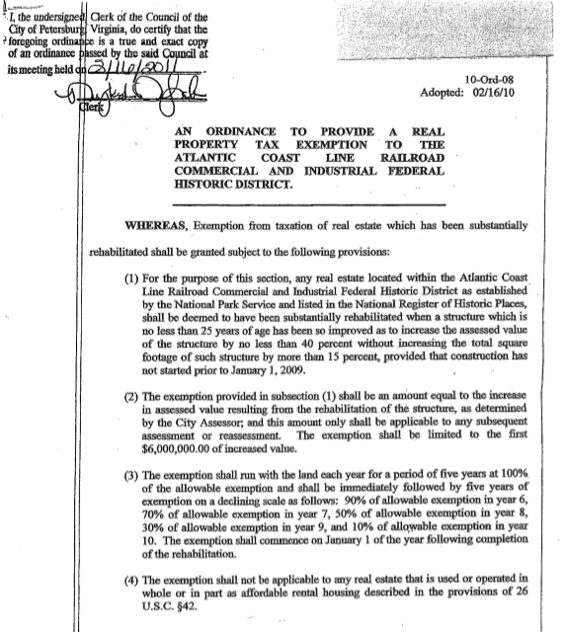
CITY ASSESSOR’S OFFICE
Brian E. Gordineer, AAS – City Assessor
Br
HOUSEKEEPING
Sec. 106-30. – Rehabilitated real estate located in the Atlantic Coast Line Railroad Commercial Commercial and Industrial Federal and Historic District.
.
Bring the benefits of rehabilitated real estate within the Atlantic Coast Line Railroad Commercial and Industrial Federal Historic District into consistency with the other designated districts. This district was omitted overlooked in 2017 when the length of the rehabilitation exemption was reduced from ten to five years, and in 2018 when the application fees were increased.

Slide 3
CITY ASSESSOR’S OFFICE
Brian E. Gordineer, AAS – City Assessor
Br
REDUCTION FOR DAMAGED & DESTROYED BUILDINGS
Sec. 106-70. – Abatement of levies on buildings razed, destroyed or damaged.
This ordinance will allow the City Assessor’s Office to lower the assessed value of buildings razed, destroyed or damaged by a fortuitous happening beyond the control of the owner for the period beyond thirty days that the building is uninhabitable.

Slide 4
CITY ASSESSOR’S OFFICE
Brian E. Gordineer, AAS – City Assessor
Br
EXEMPTION APPLICATION PROCESS
Sec. 106-138. – Miscellaneous exemptions.
This ordinance will provide the process for property owners to seek tax exempt status for a real estate parcel.

Slide 5
CITY ASSESSOR’S OFFICE
Brian E. Gordineer, AAS – City Assessor
Br
LAND USE APPLICATION FEES
Sec. 106-82. – Application for classification, assessment, etc., generally.
The amendments add an initial application fee of $500 and once every six year revalidation fee of $500 ($83 per year) to contribute administrative costs related to administration and inspection of land use parcels. On average, participants in this program pay taxes on just 22% of their assessed value.

