Slide 1

CITY ASSESSOR’S OFFICE
Brian E. Gordineer, AAS – City Assessor
Br
City Assessor’s Report
June 4, 2019

Slide 2


CITY ASSESSOR’S OFFICE
Brian E. Gordineer, AAS – City Assessor
Br
May 30-31, 2019
Washington, DC

Slide 3
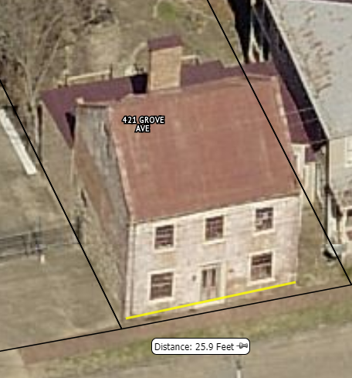
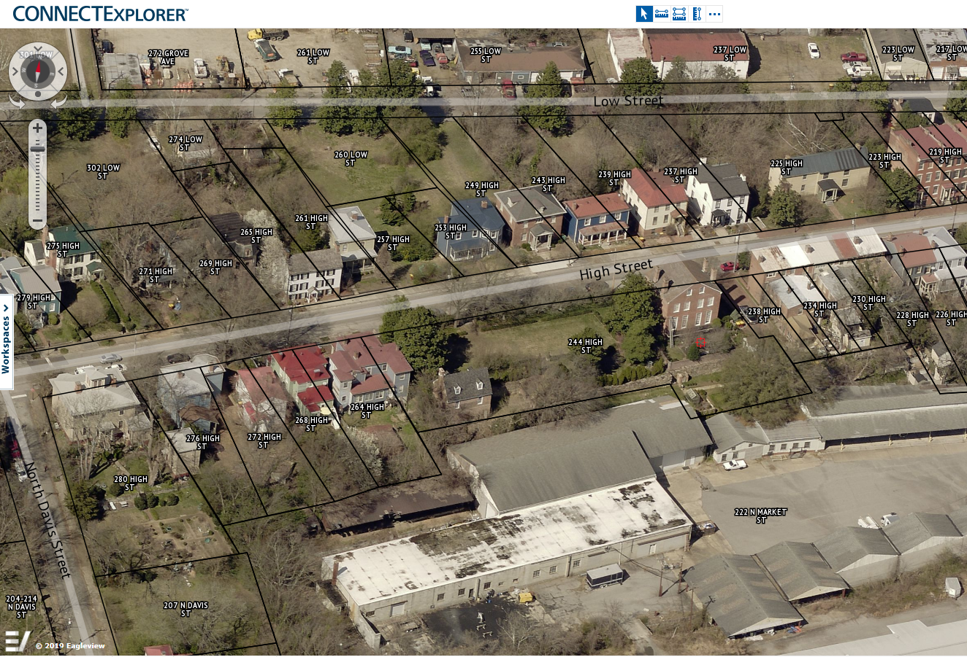
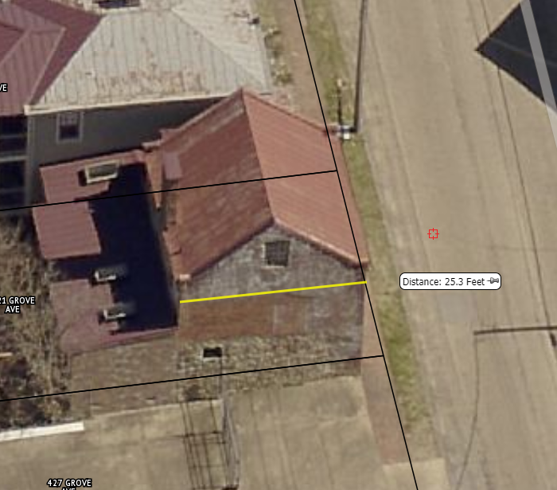
CITY ASSESSOR’S OFFICE
Brian E. Gordineer, AAS – City Assessor
Br
EAGLEVIEW
TRAINING

Slide 4
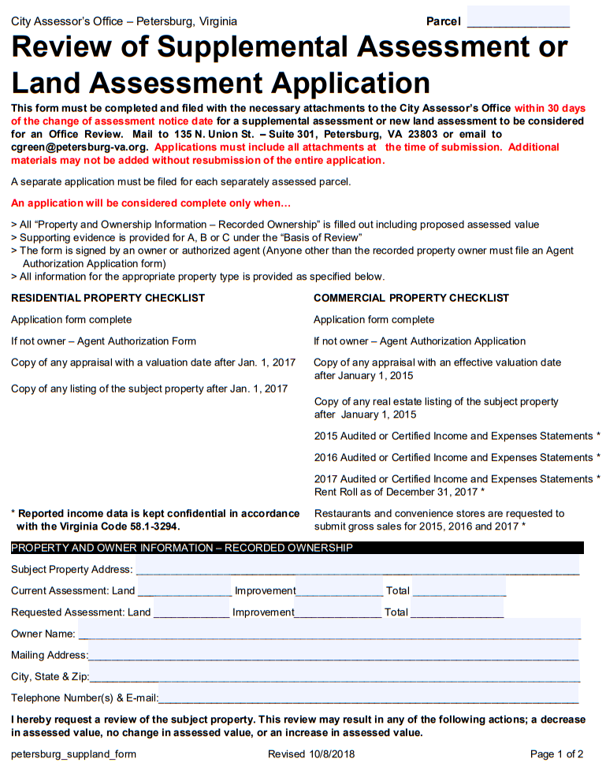
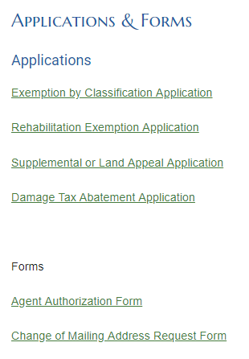
CITY ASSESSOR’S OFFICE
Brian E. Gordineer, AAS – City Assessor
Br
FILLABLE FORMS

Slide 5
CITY ASSESSOR’S OFFICE
Brian E. Gordineer, AAS – City Assessor
Br
VIRGINIA DEPARTMENT OF TAXATION
ADVANCED ASSESSOR SCHOOL
Fundamentals of Real Property Appraisal
Appraisal of Land
Principles and Techniques of Cadastral Mapping

Slide 6
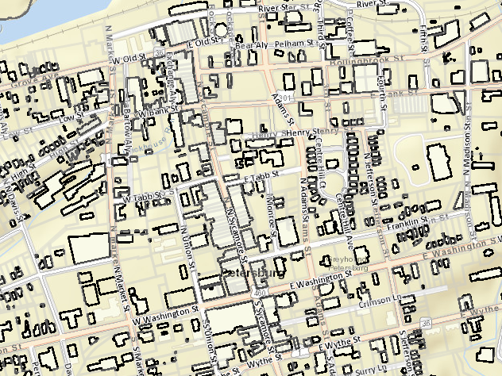
CITY ASSESSOR’S OFFICE
Brian E. Gordineer, AAS – City Assessor
Br
GIS
GIS ANALYST
Carter Chassey

